Slide 1

Interim presentation – bachelor’s thesis
Title: A comparison of the impact of auction formats used in the 2015 German spectrum auction "Mobiles Breitband - Projekt 2016" Tim Berger Munich, 13th June 2016

Slide 2
Agenda
Data Acquisition
Preliminary Results of Data Analysis
Value Model [work in progress]
Further ToDos

Slide 3
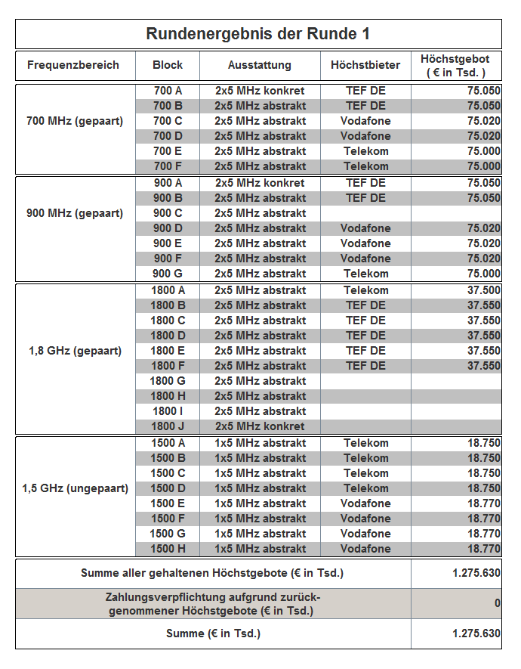
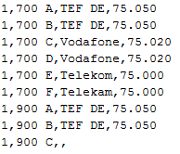
Data Acquisition
Auction data was programmatically processed in python with an OCR algorithm
Notes:
Rundendaten nur im Bildformat vorhaden
Systematisches Auslesen in Python
Ergebnis: CSV mit Rundendaten

Slide 4
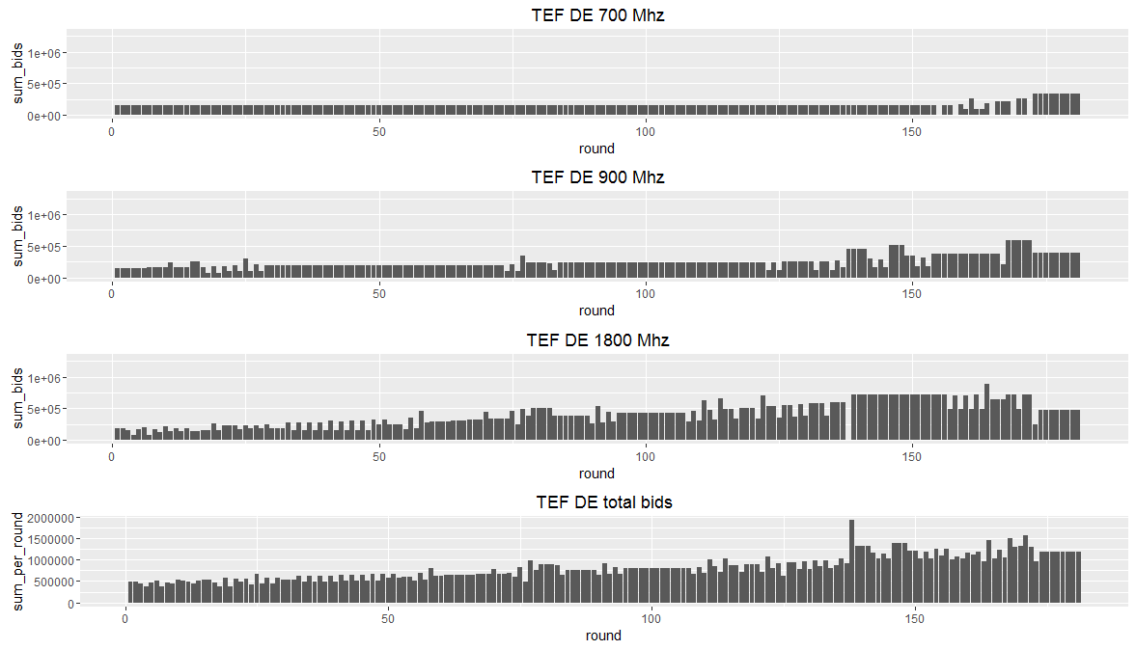
Preliminary Results of Data Analysis I
Looking at one bidder is not enough – it does not capture mututal influence of bidders
Example TEF DE
Notes:
Einzelne Betrachtung nicht ausreichend
Muss im Zusammenhang gesehen werden

Slide 5
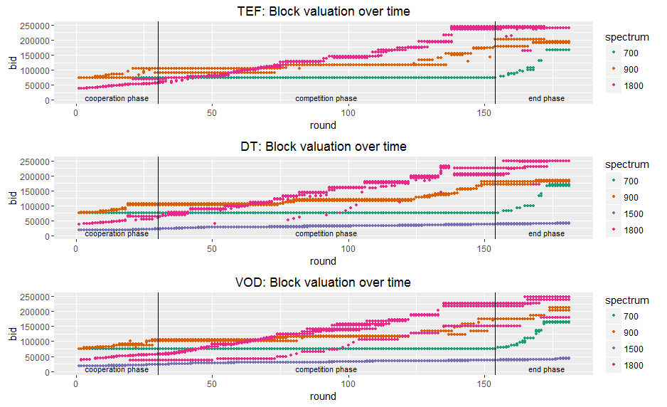
Preliminary Results of Data Analysis II
Different phases can be seen when comparing all bids over time
Notes:
Verschiedene Phasen erkennbar -> eigene Modelle für Phasen?
700 MHz: Spektrum am Anfang aufgeteilt, wenig Veränderung, Steigerungen am Ende weniger durch Nachfrage als durch Bedrohung durch andere MNOs
Spannende Spektren: 900 MHz, 1800 MHz

Slide 6
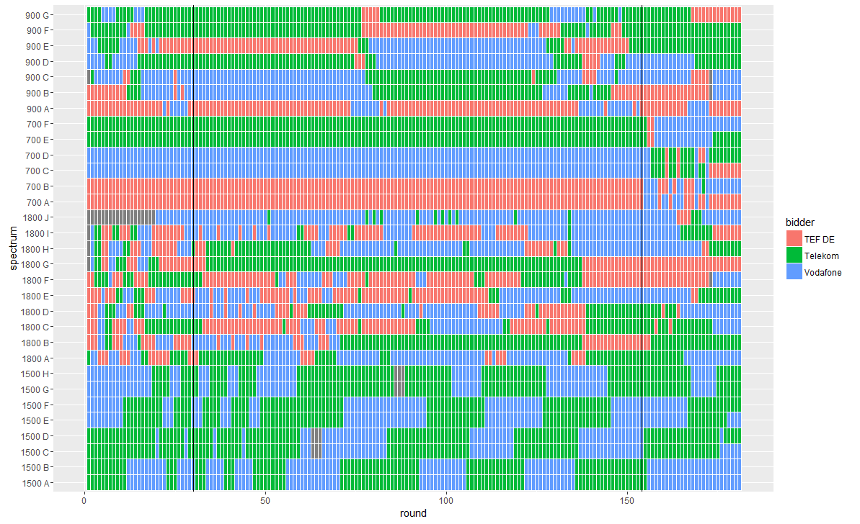
Preliminary Results of Data Analysis III
Who wins what in each round

Slide 7
Value Model [work in progress]
Technical aspects and market situation
700 MHz
not owned by any MNO before auction
most likely used for LTE
900 MHz
Spectrum Cap at 3 blocks per MNO
Value of acquiring three blocks >> acquiring two blocks
1800 MHz
for LTE: 4 or 6 blocks most valuable
for GSM: any block is valuable
1500 MHz
not owned by any MNO before auction
TEF did not bid on any 1500 block

Slide 8
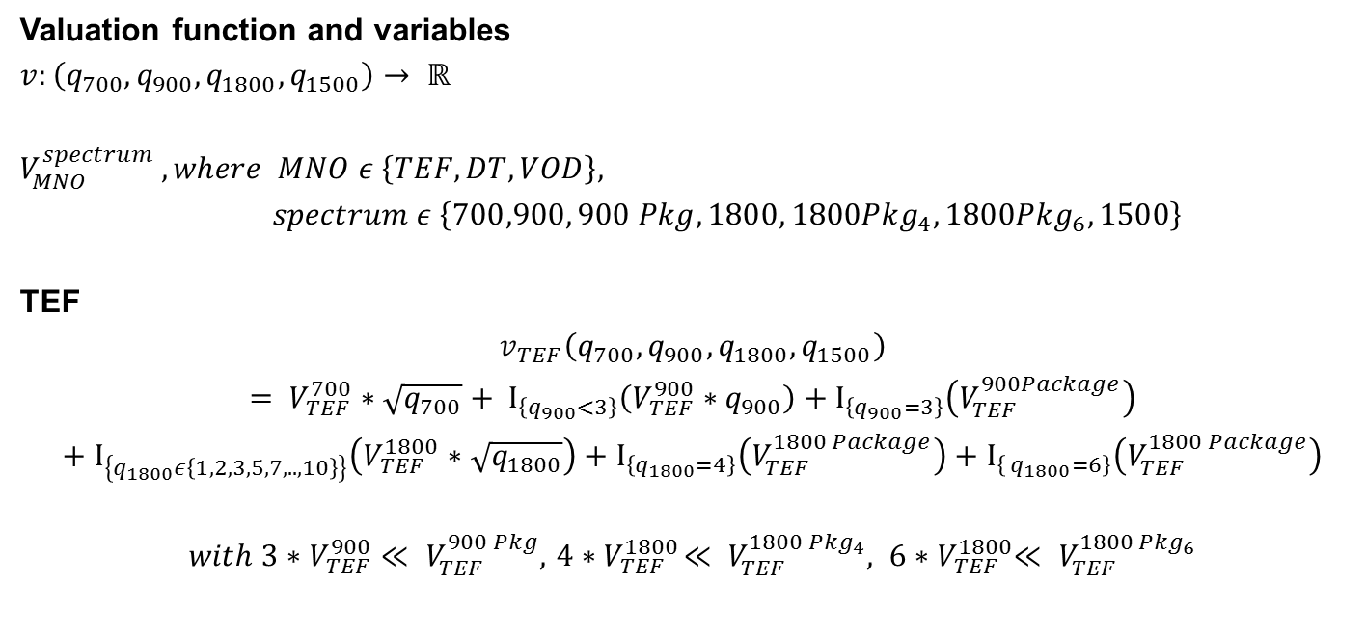
Value Model [work in progress]
Mathematical formulation
Valuation function and variables
$$v:\left(q_{700},q_{900},q_{1800},q_{1500}\right)→ ℝ$$
$$V_{MNO}^{spectrum} , where MNO ε \left\{TEF, DT, VOD\right\},$$
$spectrum ε \left\{700,900, 900 Pkg,1800, {1800Pkg}_{4},{1800Pkg}_{6}, 1500\right\}$
TEF
$$v_{TEF}\left(q_{700},q_{900},q_{1800},q_{1500}\right)= V_{TEF}^{700}∗\sqrt{q_{700}}+ Ι_{\left\{q_{900}<3\right\}}\left(V_{TEF}^{900}∗q_{900}\right)+Ι_{\left\{q_{900}=3\right\}}\left(V_{TEF}^{900Package}\right)+Ι_{\left\{q_{1800}ε\left\{1,2,3,5,7,..,10\right\}\right\}}\left(V_{TEF}^{1800}∗\sqrt{q_{1800}}\right)+Ι_{\left\{q_{1800}=4\right\}}\left(V_{TEF}^{1800 Package}\right)+Ι_{\left\{{ q}_{1800}=6\right\}}\left(V_{TEF}^{1800 Package}\right)$$
$with{ 3∗V}_{TEF}^{900}≪ V_{TEF}^{900 Pkg},{ 4∗V}_{TEF}^{1800}≪ V_{TEF}^{1800 {Pkg}_{4}},$ ${ 6∗V}_{TEF}^{1800}≪ V_{TEF}^{1800 {Pkg}_{6}}$
Notes:
VPkg könnten über R181 Werte abgeleitet werden

Slide 9
Further ToDos
Revise model according to:
Exposure problem and technical implications
Modelling of debased blocks
Take into account already owned spectrum of MNOs?
…
- …

Slide 10
Thank you for your attention!

Slide 11
Backup

Slide 12
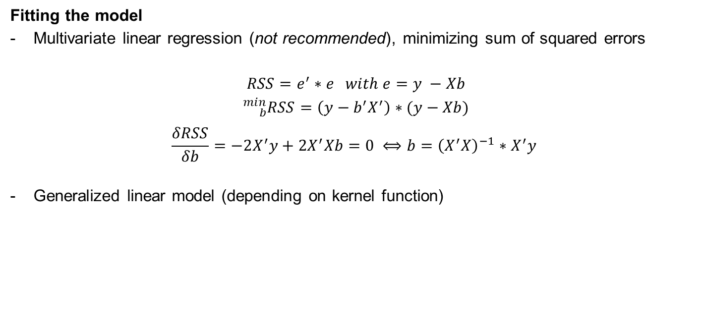
Value Model [work in progress]
Suggestion: How to derive the model‘s parameters
Fitting the model
Multivariate linear regression (not recommended), minimizing sum of squared errors
$$RSS=e^{′}∗e with e=y −Xb$$
$${}_{b}^{min}{RSS=\left(y−b^{′}X^{′}\right)∗(y−Xb)}$$
$$\frac{δRSS}{δb}=−2X^{′}y+2X^{′}Xb=0 ⟺b={\left(X^{′}X\right)}^{−1}∗X^{′}y$$
Generalized linear model (depending on kernel function)

Slide 13
Value Model [work in progress]
Technical aspects
700 MHz: most likely used for LTE
900 MHz:
Spectrum cap: max. 3 block per MNO (2 for LTE and 1 GSM or all 3 for GSM)
Value of two blocks << Value of three blocks
1800 MHz: 6 x (2x5) leads to significant speed advantage in LTE!
1500 MHz: non-mainstream band

Slide 14
Value Model [work in progress]
Assumptions and notes
Spectrum | General Info | TEF | DT | VOD
700 MHz | - No bidder had
900 MHz
1800 MHz
1500 MHz

Slide 15
Preliminary Results of Data Analysis III
Summary of bids
Bidder | Phase | 700 mean | 900 mean | 1800 mean | 1500 mean
TEF | Coord
TEF | Comp
TEF | End
DT | Coord
DT | Comp
DT | End
VOD | Coord
VOD | Comp
VOD | End

